Slide 1
Designing RF antennas with Ansys HFSS
Huan Q. Bui
ZGS July 7, 2023

Slide 2
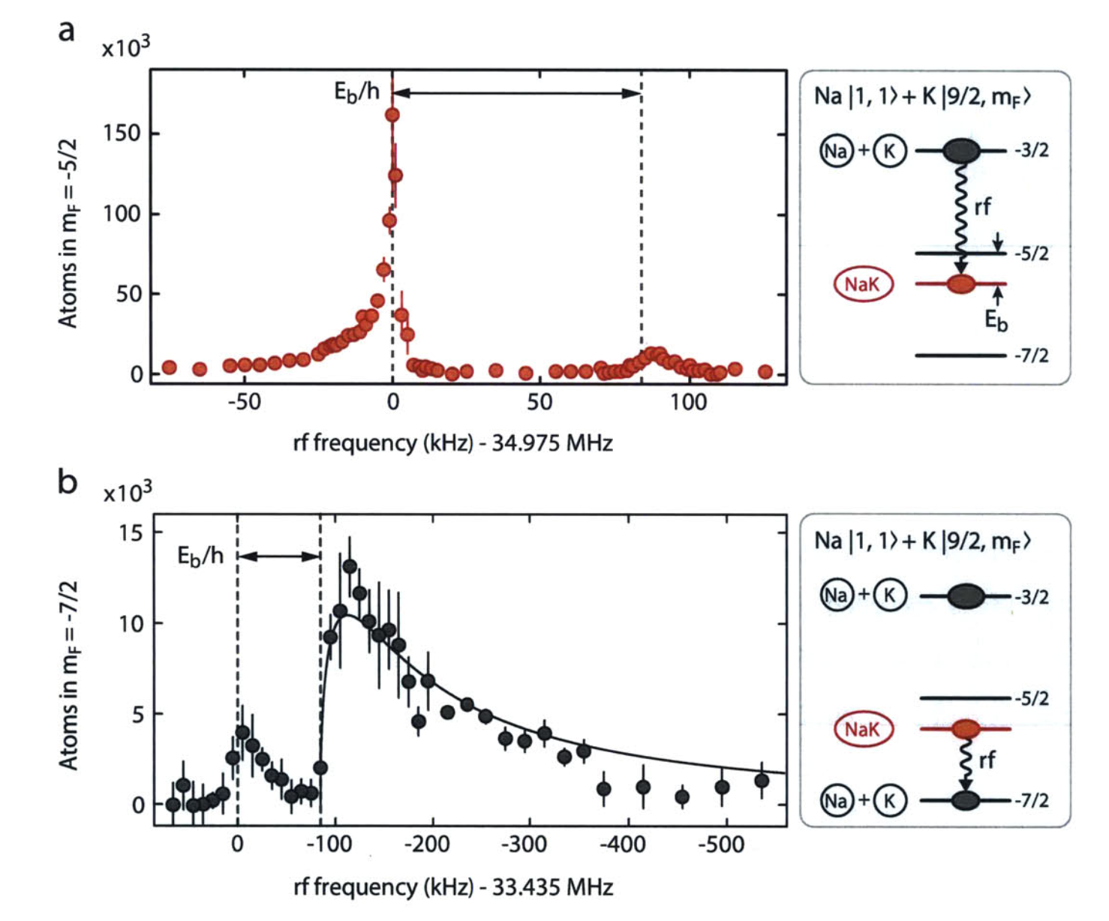
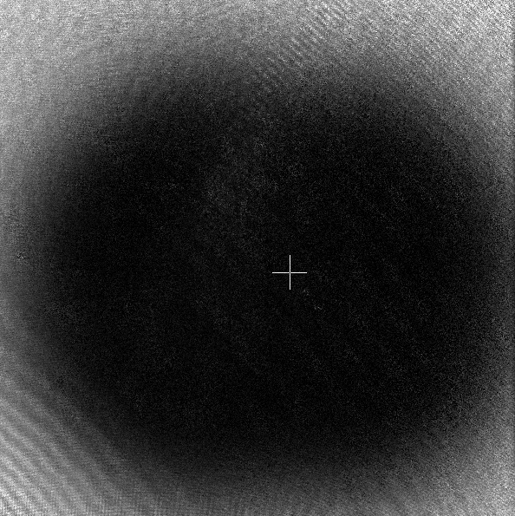
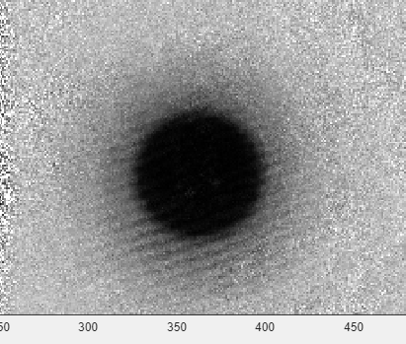
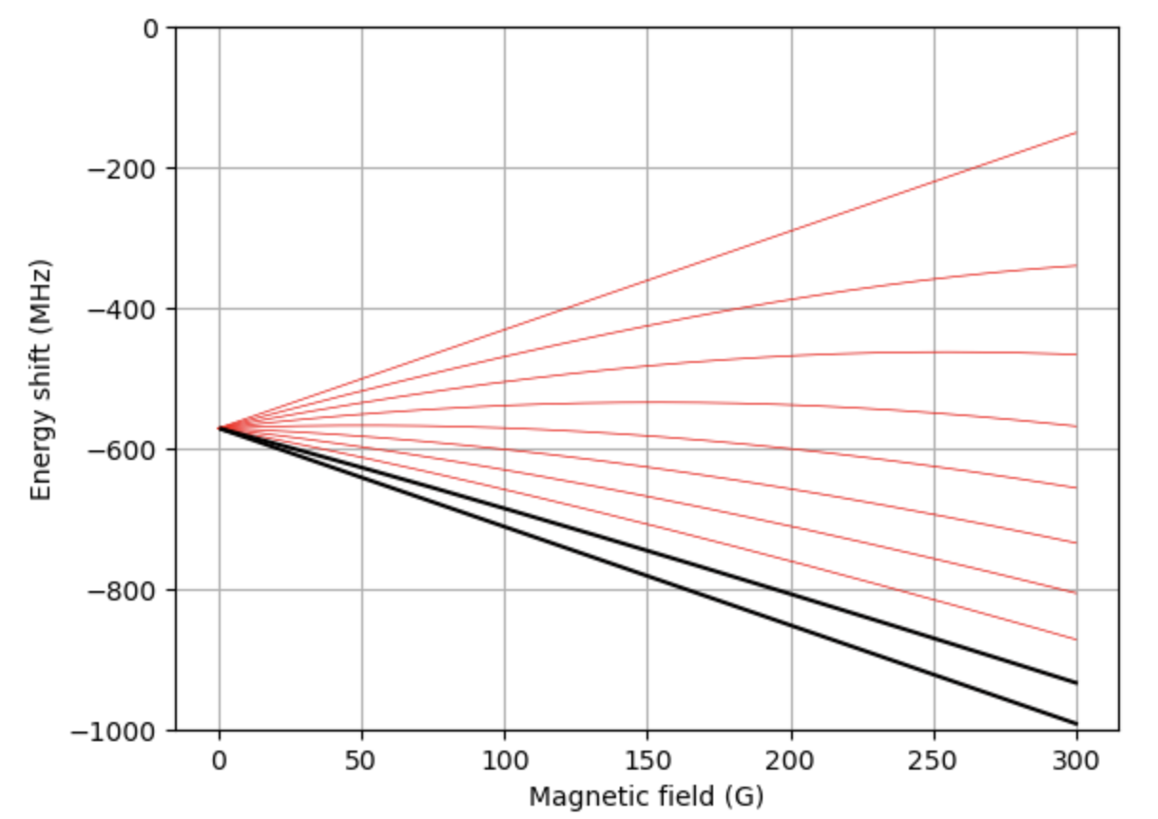
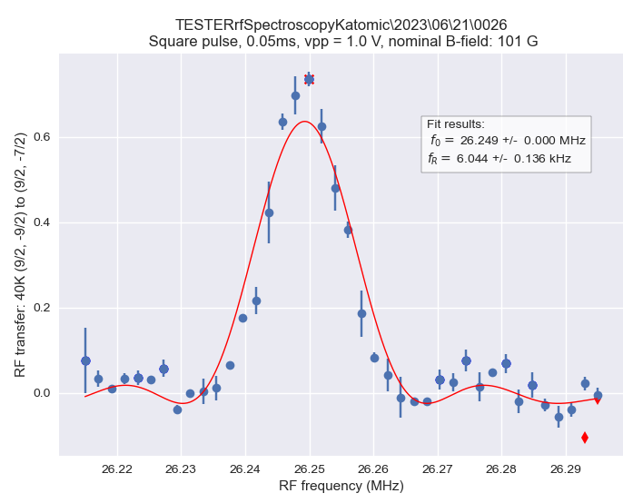
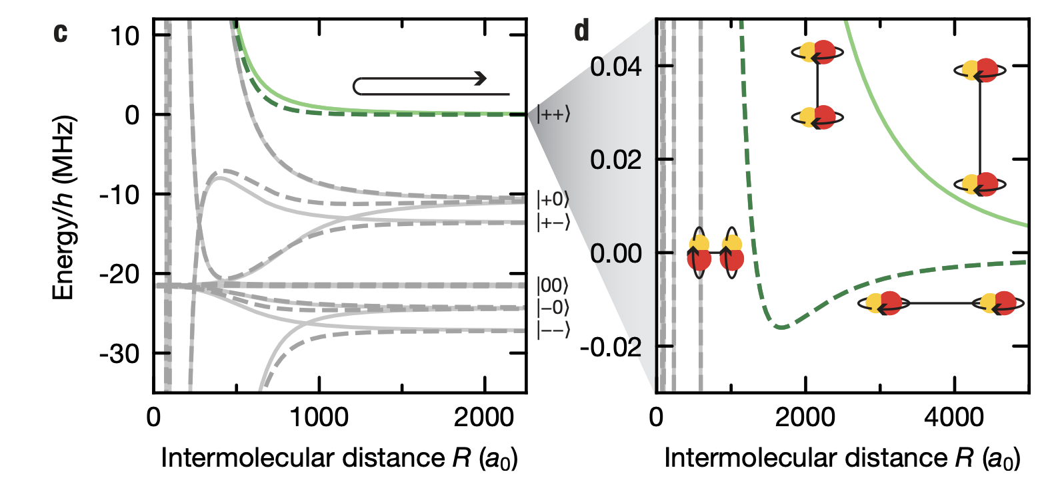
Why RF antennas?
Make/break molecules
RF evaporation
Cheng-Hsun, W., et al., Phys. Rev. Lett 109 (2012): 085301.
Spin manipulation
Tune molecular interactions (promised ZGS?)
Schindewolf, Andreas, et al. Nature 607.7920 (2022): 677-681.

Slide 3
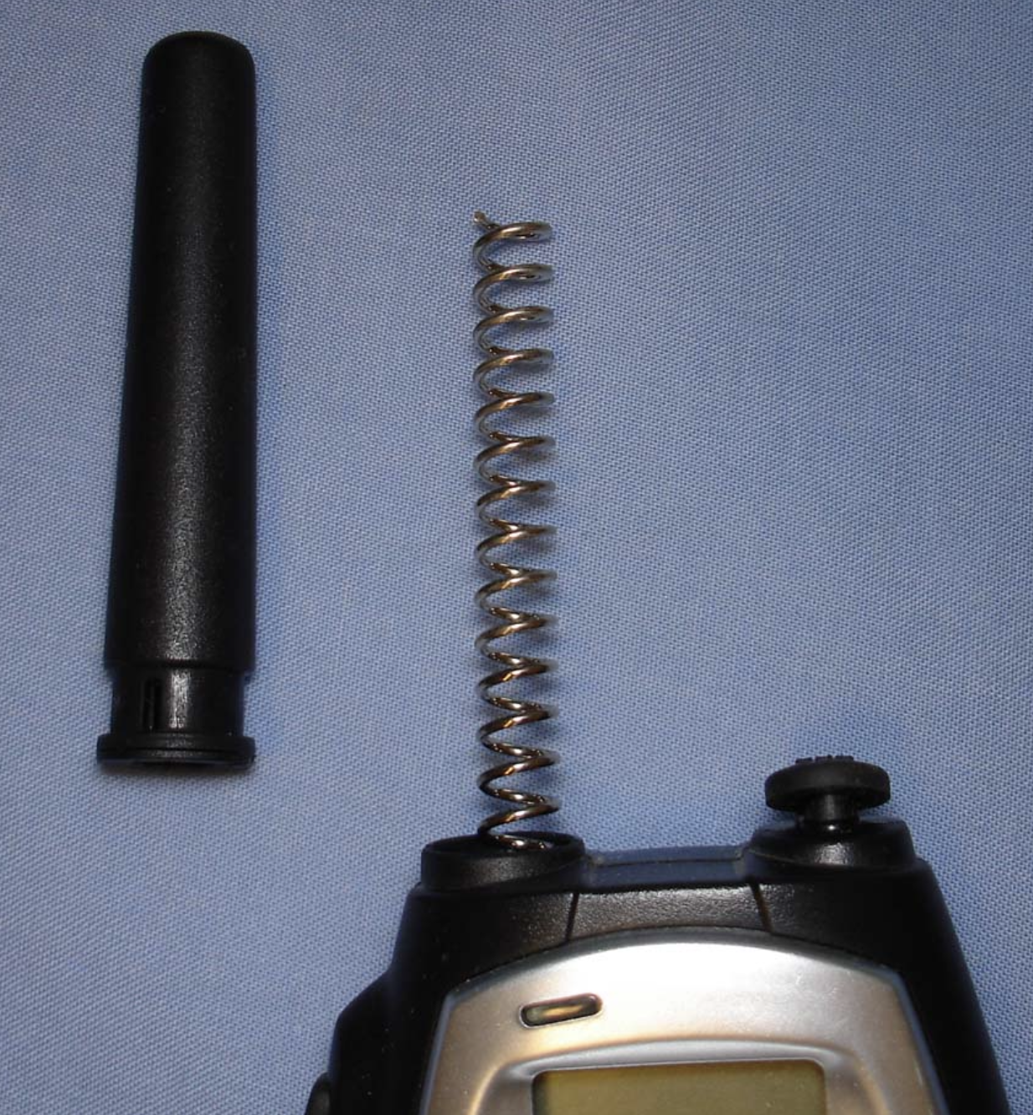
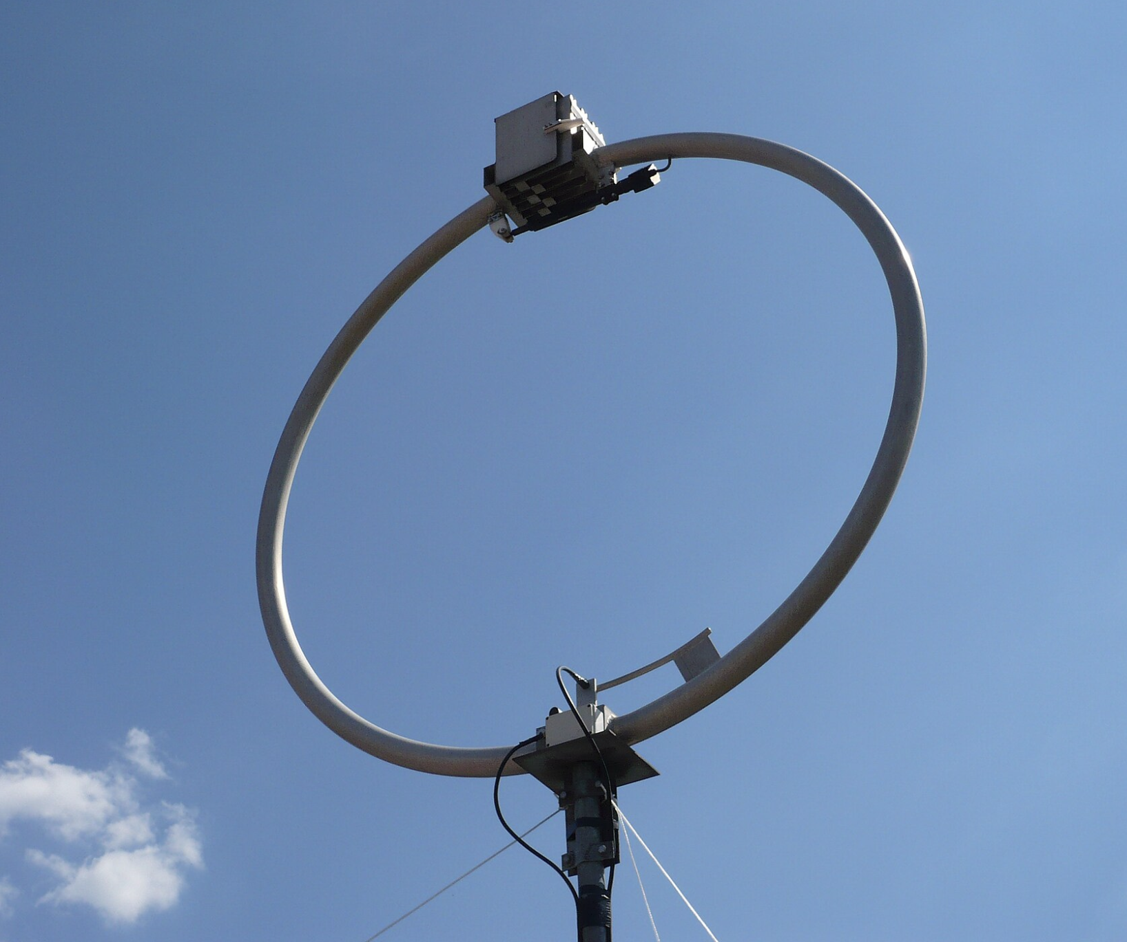
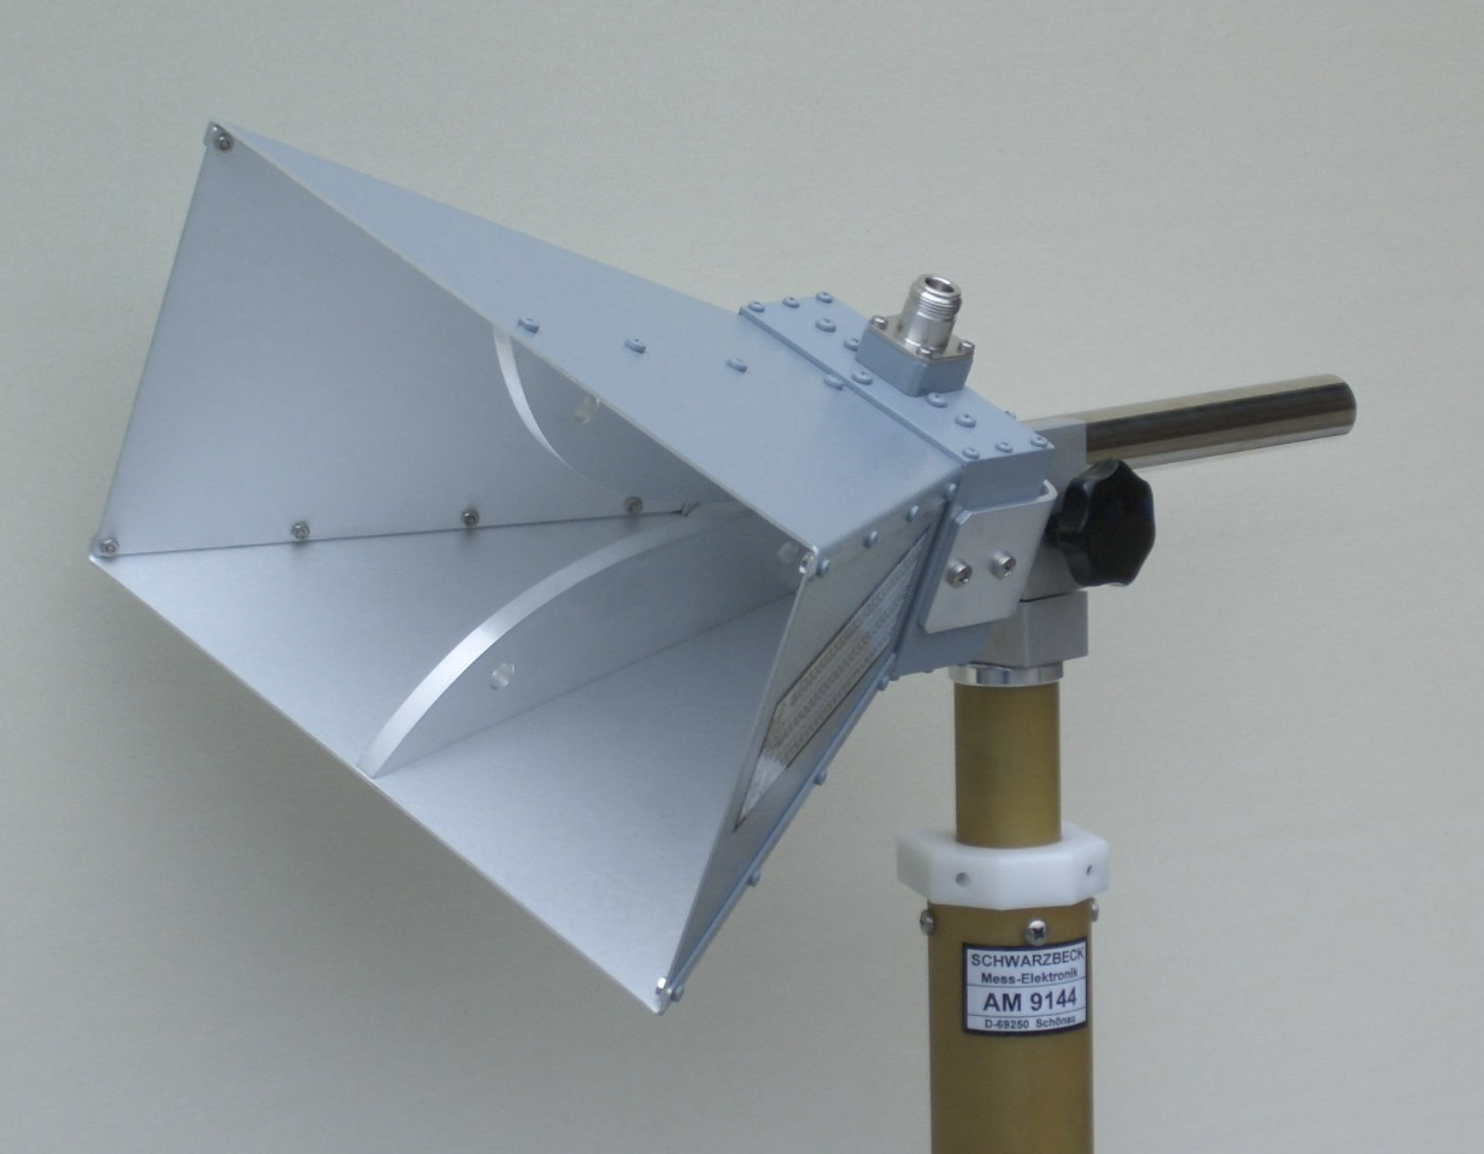
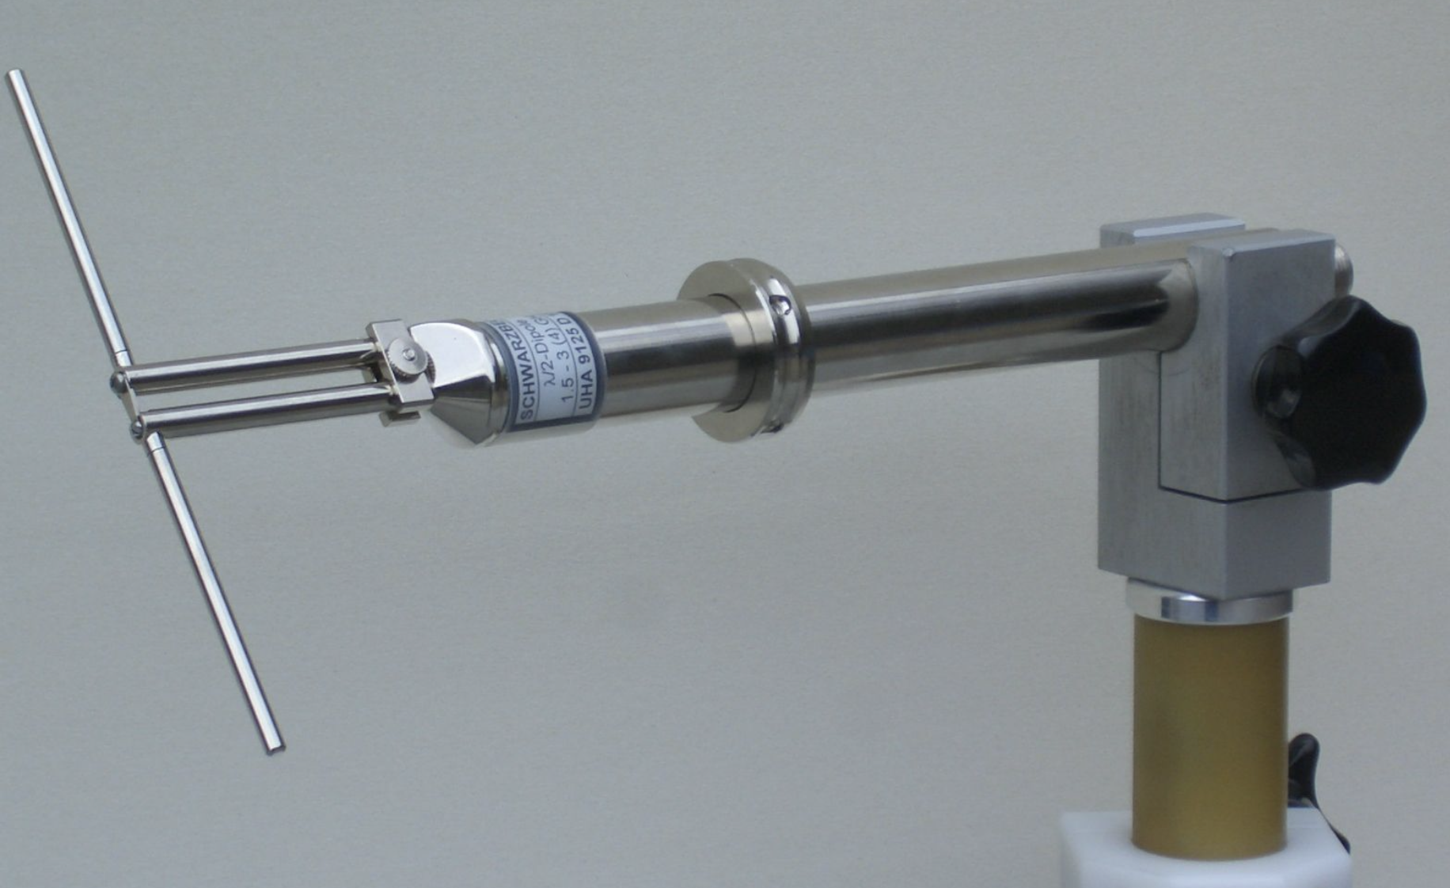
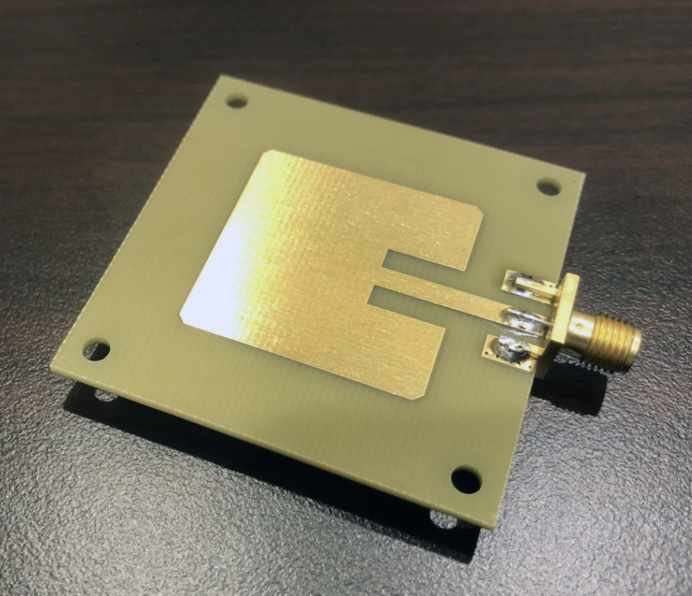

RF antennas in nature

Slide 4
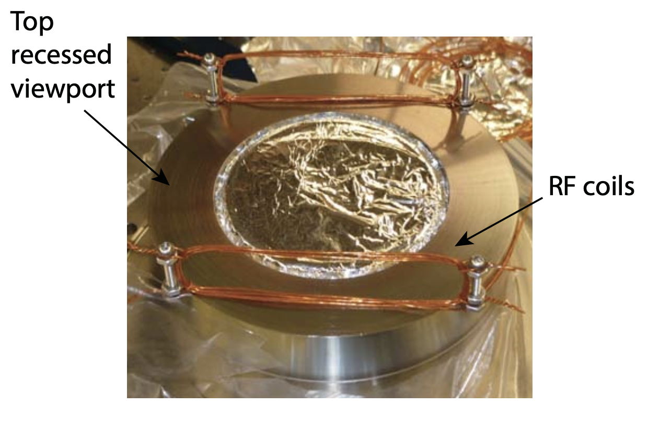
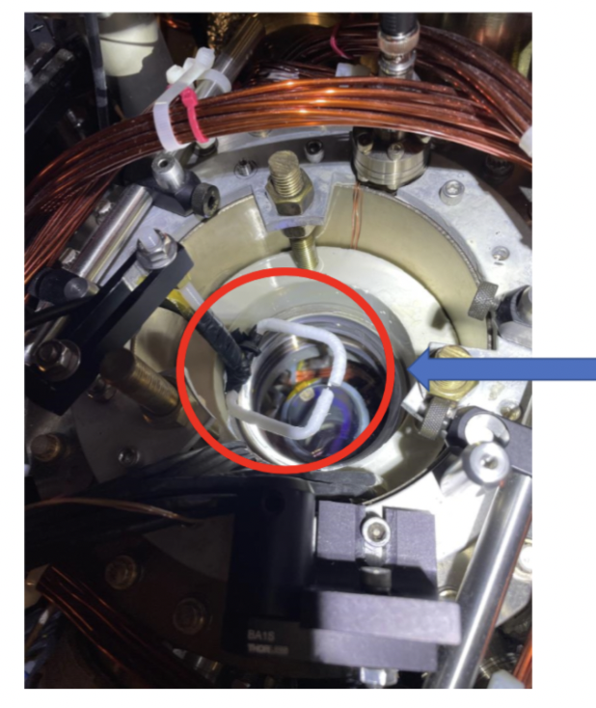
RF antennas in the lab (Fermi1)
for K spin
manipulation
F1 outer antenna
for Na RF Evap
CHW thesis
PC: Alex

Slide 5
Antenna design considerations
Type & material
Operating frequency range
Polarization of radiation
Antenna matching (“resonance”)
Tunability
Environmental effects
Cost (time and money)
Want:
Simulations before prototyping
Confidence in design
Understanding of antenna behavior
Reproducibility
Don’t want:
Design by trial and error (ineffective)
Not understanding antenna behavior
Voo-doo! Not reproducible

Slide 6
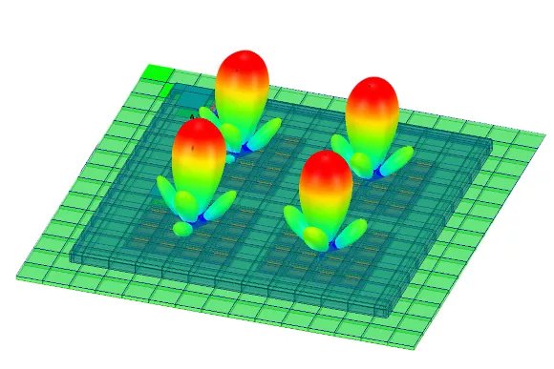
Ansys HFSS
Free*, powerful 3D EM solver
Relatively easy to learn and use:
Watch tutorials (YT/Ansys classes)
Build antenna
Set up solution and solve
Optimize
Alternatives:
COMSOL (very not free, IS&T has no license)
MATLAB (not enough features)

Slide 7
Modeling a waveguide antenna with Ansys HFSS in 10 steps

Slide 8
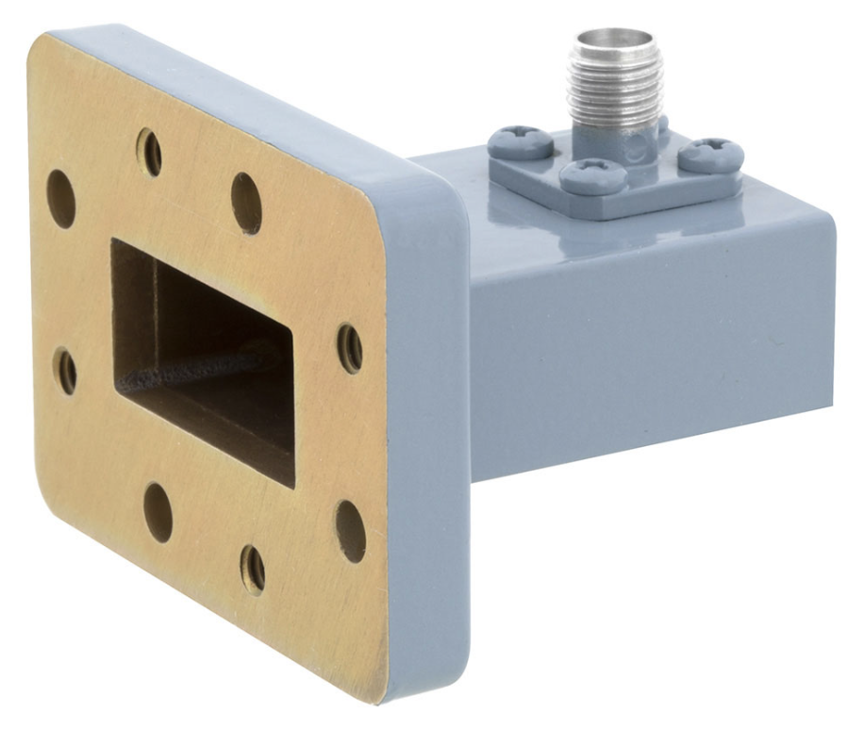
Step 1: Waveguide antenna requirements & dimensions
Operational frequency: 5.640 GHz
Tunable polarization
Direct radiation with high amplitude
Rectangular waveguide antenna
Width: needs lower frequency cutoff of TE01 < 5.64 GHz → a = 33 mm
Length: To be optimized
Feeds: Naively, 2 perpendicular feeds. 13 mm from backwall*, 10 mm tall
Hole in the backwall for the MOT beam
Inspired by Xing-Yan Chen et al, Nature, volume 614, pages 59–63 (2023)

Slide 9
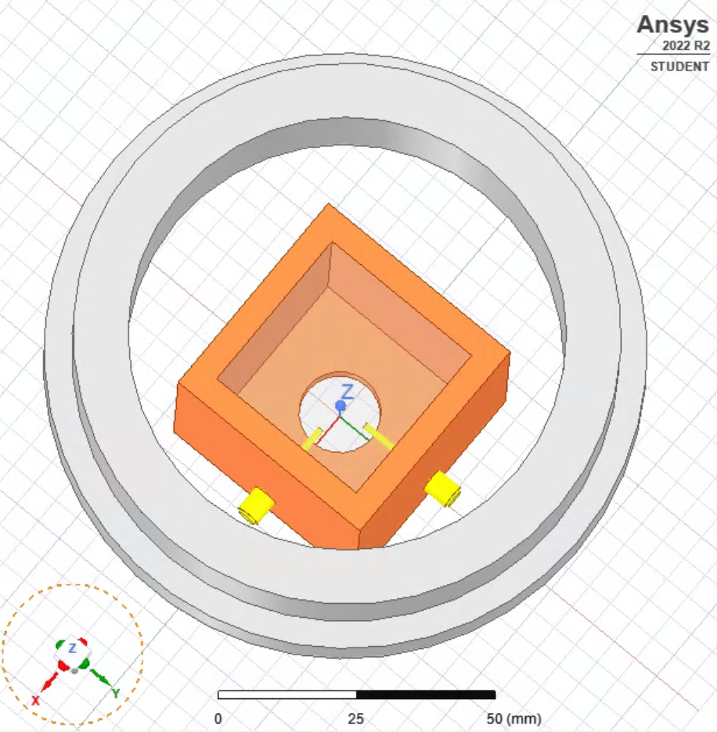
Step 2: Build the antenna in Ansys HFSS
<<< insert most current design, without the chamber! >>>
Remember to parametrize
Specify material
Feed dimensions: SMA stub connectors
Steel “ring” for the chamber window

Slide 10
Step 3: Define boundary conditions

Slide 11
Step 4: Define excitations

Slide 12
Step 5: Setup solution

Slide 13
Step 6: Validate and solve

Slide 14
Step 7: View results

Slide 15
Step 8: Study

Slide 16
Step 9: Optimize/Revise

Slide 17
Step 9: Optimize/Revise
Show results with the quad-feed design here

Slide 18
Step 10: Finalize

Slide 19
Summary:

Slide 20
The end

Slide 21
Extra notes:
Refer to Guide to Coax to Waveguide paper?
Focus on the counter-intuitive polarization tuning as the reason for doing all of this in Ansys. Emphasize that I did not expect this behavior, and so it was very helpful to have done this in software before trying something in the lab. Would have been very confused.
Emphasize that the total time spend on learning all the basics was only about a weekend of intense YT-watching and following examples, while the rest of the time was spent on trying to understand/optimize, etc.
Say that there are other aspects that I have not had time to go through as well. Waveguide physics is also part of this. In real-world applications people have different designs for waveguide antennas: horns and ridges. These are more complicated and probably not worth our time, but can always try later.
Talk about impedance matching.
Talk about the existence of the optimization feature which I didn’t use this time, but not so hard to set up.

